Slide 1
Unsupervised Time Series Anomaly Detection Peter Chen

Slide 2
Anomaly detection
Traditional Anomaly Detection in Aerospace
Tiered alarm systems using manually set thresholds and aggregate visualization of data
Examples of anomalies: Vibration failure, Engine stall, Component liberation, Engine fire
Challenges
Lots of manpower needed to create thresholds
Lack of failure data - extreme class imbalance
High Dimensional – difficult to visualize
Non-stationary – changing contexts (ex. Different ambient conditions)
One size fits all thresholding technique is not suitable for non-stationary data
Potential Solution
Unsupervised learning
Learn to model nominal behavior
Assess reconstruction error for new data points to determine likelihood of anomaly

Slide 3
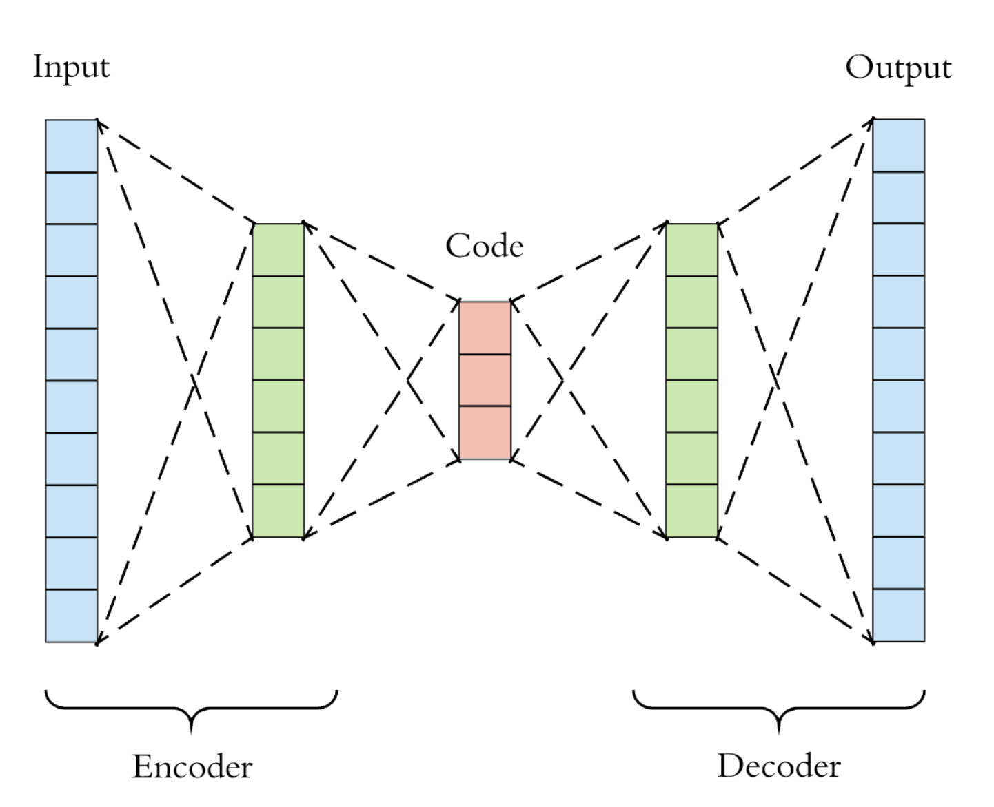
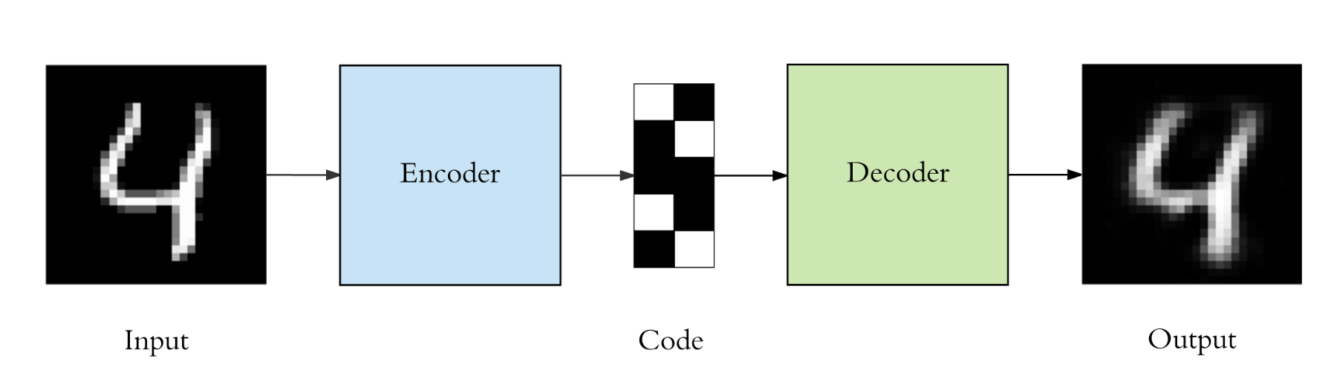
Neural Network Autoencoders
Autoencoder structure
Symmetric neural network where inputs = outputs
Utilize a bottleneck to reduce dimensionality to Learn a simpler representation of the data
Similar to Principal Component Analysis (PCA) except that autoencoders are non-linear
Common use case - anomaly detection, image processing, information retrieval
bottleneck
Example Use Case
Notes:
T-sne – clustering

Slide 4
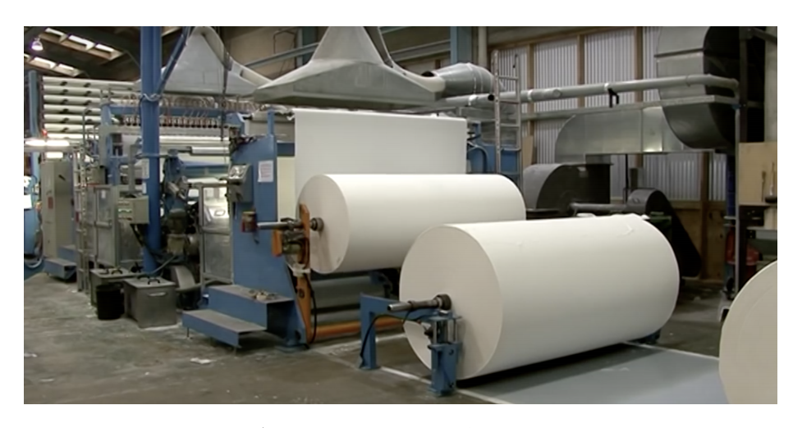
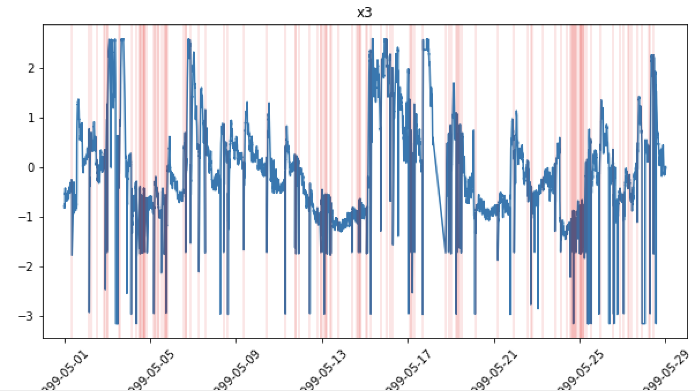
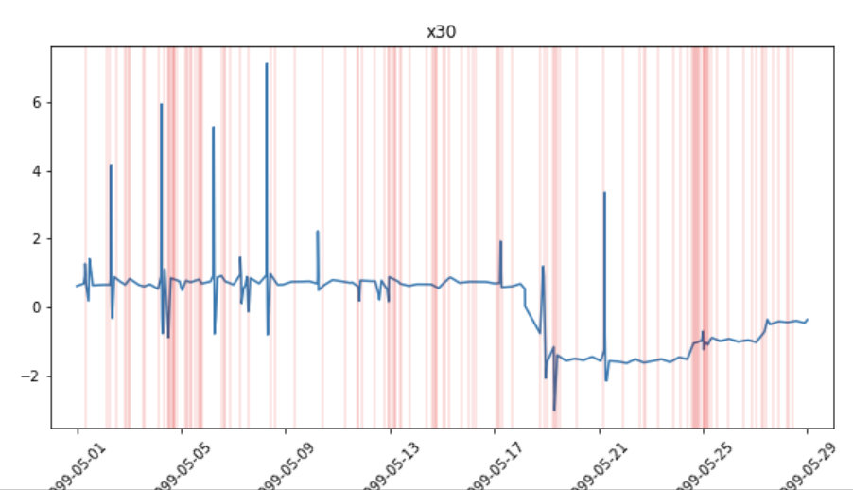
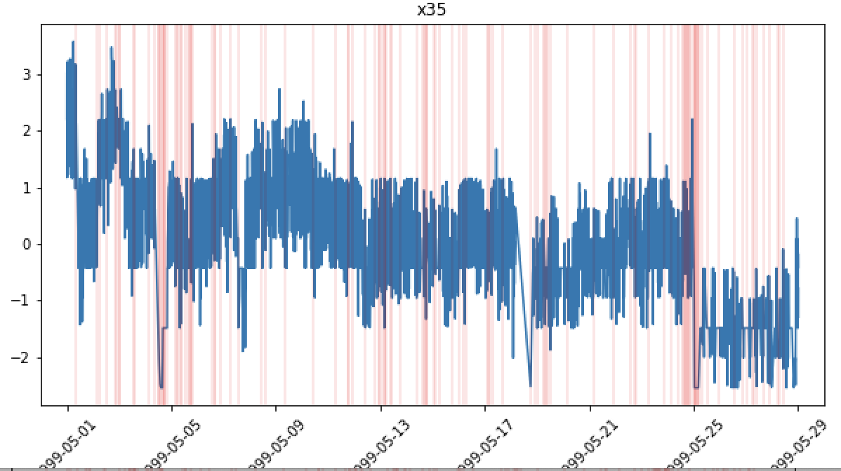
Dataset #1: Time series of Paper Mill Sensors
https://arxiv.org/pdf/1809.10717.pdf
Time series dataset of paper mill with 60 sensor parameters and 1 binary target variable indicating failures
Failures represent when the paper breaks, breaks can take over 1 hour to resolve
~18K records over 1 month of usage (sampled every 2 minutes)
Large class imbalance – 124 failure vs 18,274 non-failure points (failures in red)
In the paper, the best supervised model (XGBoost) had F1 score of .11
Oversampling used to balance labels with 90/10 train/test split

Slide 5

Data Preprocessing – Autoencoder
CSV file
Drop categorical variables
Binary target variable padding
Standard scaler
Train/test split
Keep 59/61 variables
Allow for early prediction intervals
Train = 90% of non-failures
Test = 10% of non-failures and 100% of failures

Slide 6
Autoencoder
Anomaly Detection
Train on non-failure data
Predict on test data (non- failure + failures)
Calculate reconstruction error for test data
Reconstruction error aggregation (mean and abs)
Classify anomaly based on error threshold
- Set threshold based on training data error
- try 3 sigma, 5 sigma, and max threshold
Input – 59 sensors (nominal)
Dense layer
(32 units)
Dense layer
(16 units)
bottleneck
Dense layer
(32 units)
Linear activation
Output – 59 sensors (nominal)
Batch = 12
Epochs = 50
Loss = mean squared error
Notes:
Bayesian neural net

Slide 7
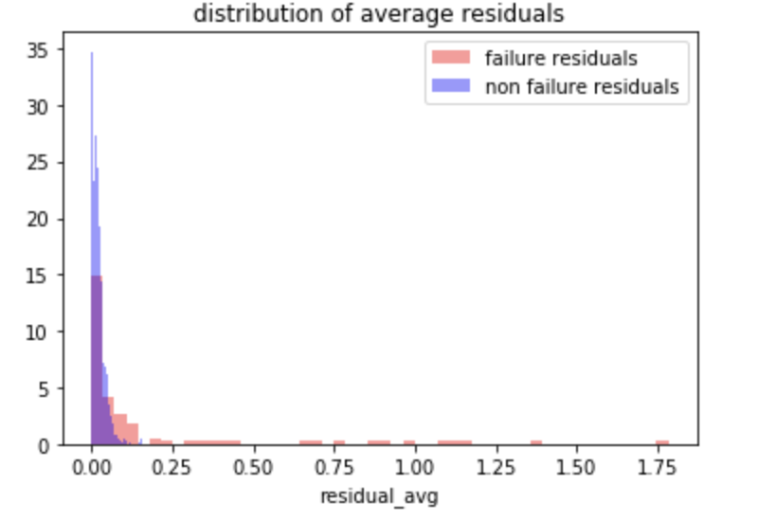
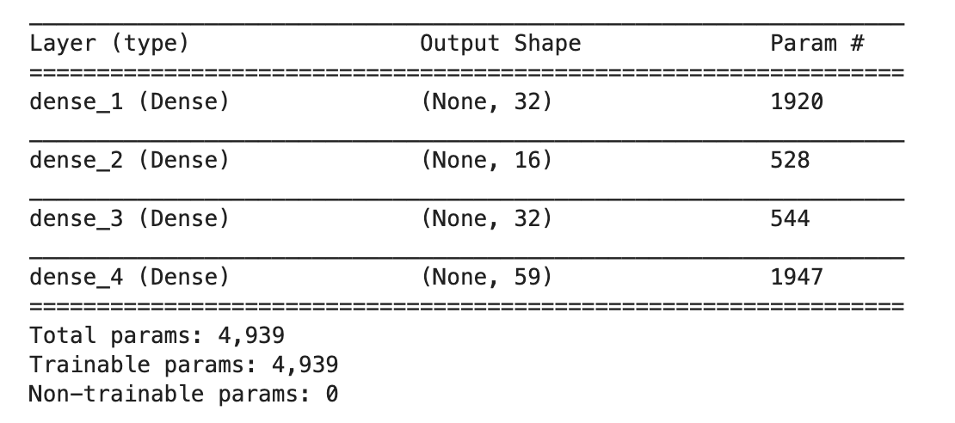
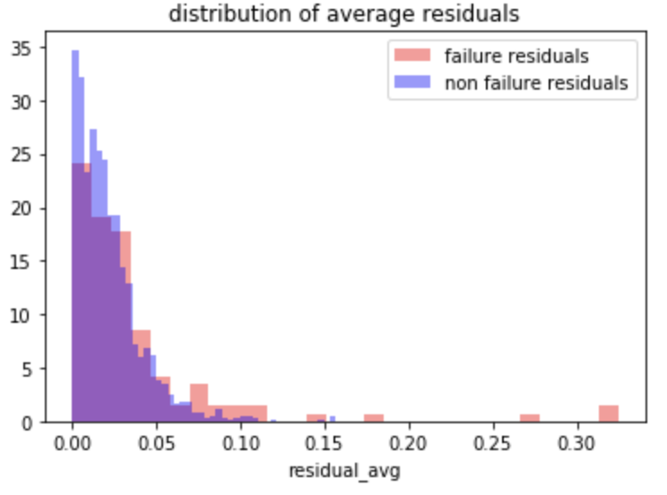
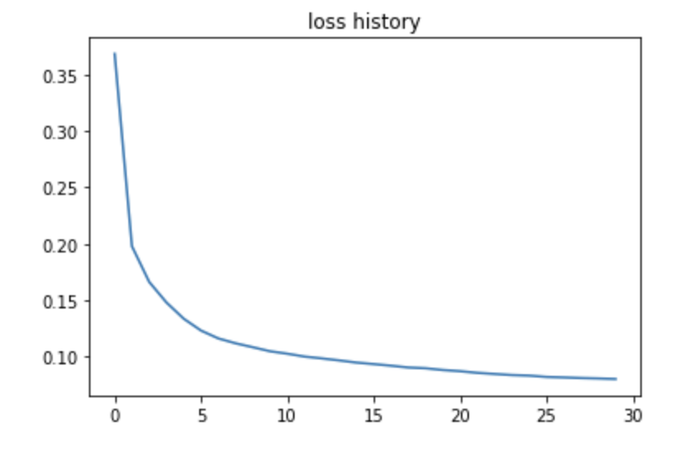
Preliminary Results
Test Residuals
Autoencoder weights – 5K params
Non failures
Failure – early interval = 1
Loss Curve
Failure – early interval = 2
Training time = 1 second per epoch
Early interval = 1 shows better separation of failures

Slide 8
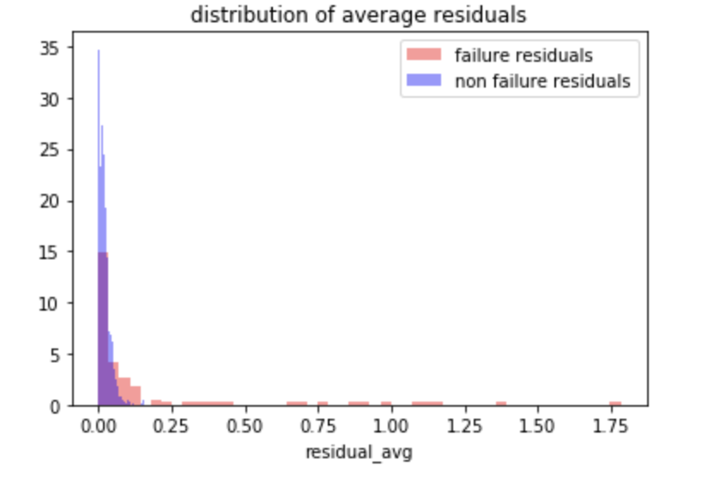
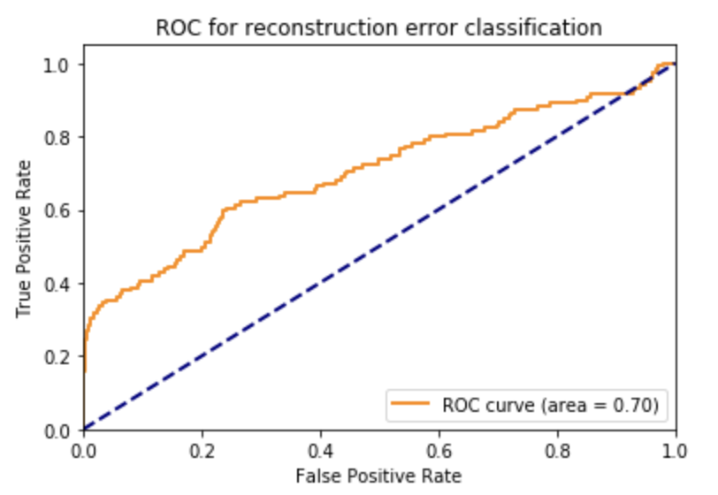
Model Metrics for detecting with early interval of 1
Test Residuals
Threshold 3s
Failures
Thresholds calculated based on training data – 3 sigma and max residual
Perform classification based on threshold
Early interval = 1
ROC AUC is chosen metric since it assess multiple thresholds
 | XGBoost (Paper) | 3σ threshold | 5σ threshold
Topology | NA | 32-16-32 | 32-16-32
Precision | .51 | .554 | .84
Recall | ~.07 (inferred) | .303 | .218
F1 Score | .11 | .391 | .347
ROC AUC | Not provided | .70 | .70
Autoencoder shows more promise than XGBoost model

Slide 9
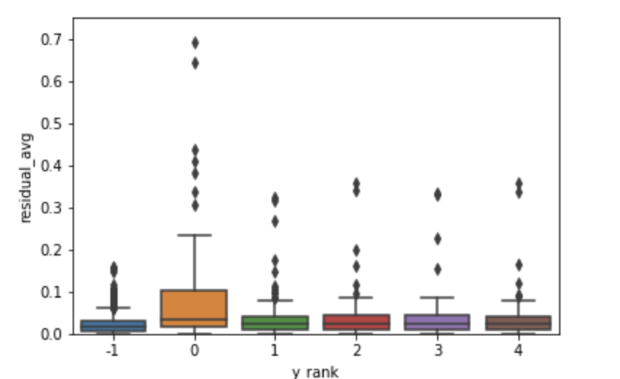
Residual distribution vs early prediction interval
 | Early 1 | Early 2 | Early 3
Topology | 32-16-32 | 32-16-32 | 32-16-32
Precision | .554 | .293 | .216
Recall | .303 | .98 | .065
F1 Score | .391 | .147 | .1
ROC AUC | .70 | .60 | .60
Non
failures
Early = 1
Early = 2
Early = 3
Early = 4
Early = 5
Autoencoder’s predictive capability deteriorates as early interval increases

Slide 10
Different Topology comparison
Threshold = 3 sigma training error
Early prediction interval = 1
Batch size = 12
Epochs = 50
Topology | Complex | Base Case | Simple
Topology | 32-16-8-16-32 | 32-16-32 | 16
Precision | .682 | .554 | .655
Recall | .252 | .303 | .15
F1 Score | .368 | .391 | .257
ROC AUC | .68 | .70 | .65
3 Layer auto encoder performed the best
Performance hovers around ~.68 AUC

Slide 11
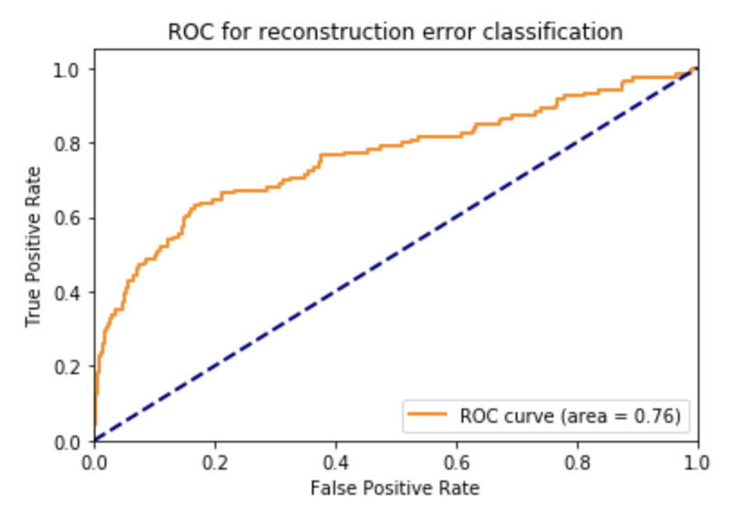
Different Feature Comparison
All 61 features
Threshold = 3 sigma training error
Early prediction interval = 1
Batch size = 12
Epochs = 50
Topology = tune for each feature set
Hidden Layer Shape | All features - 59 | Top 15 XGBoost Features
Topology | 32-16-32 | 12-6-12
Precision | .554 | .549
Recall | .303 | .235
F1 Score | .391 | .329
ROC AUC | .70 | .76
Top 15 features
Preliminary Feature selection improved model

Slide 12
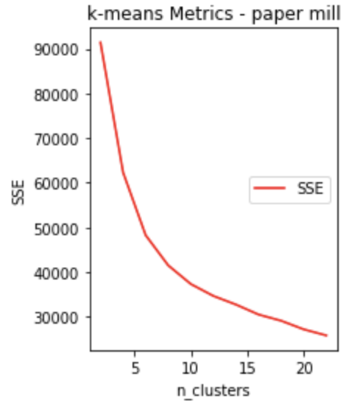
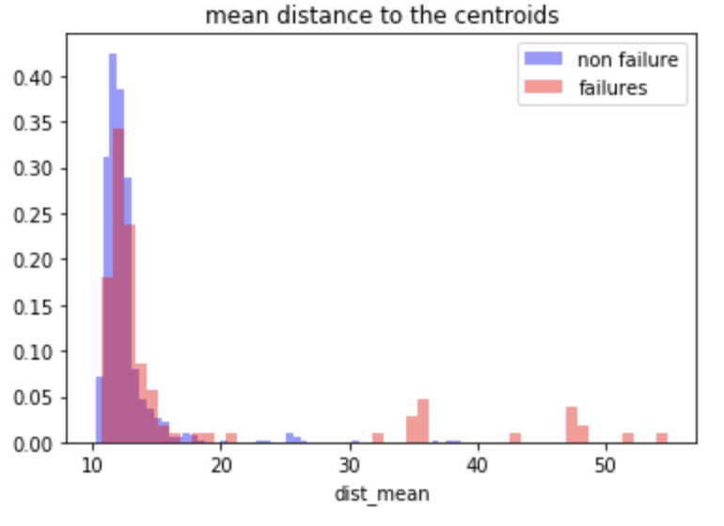
Comparison to K means clustering anomaly detection
Step 1: Chose 5 clusters based on SSE elbow plot
Step 2: Fit clusters on train data (non-failures)
Step 3: Obtain L2 distances to 5 centroids for test data
Step 3: Find mean distance to centroids
Step 4: Classify based on 3 sigma threshold for mean distance based on training data
Early prediction interval = 1
Early Interval = 1 | Autoencoder | Km - sensor inputs | Km - encoded outputs
Precision | .554 | .447 | .098
Recall | .303 | .176 | .034
F1 Score | .391 | .253 | .05
ROC AUC | .70 | .58 | .51
K means sets a baseline for performance
Combination of K means + Autoencoders performs poorly

Slide 13
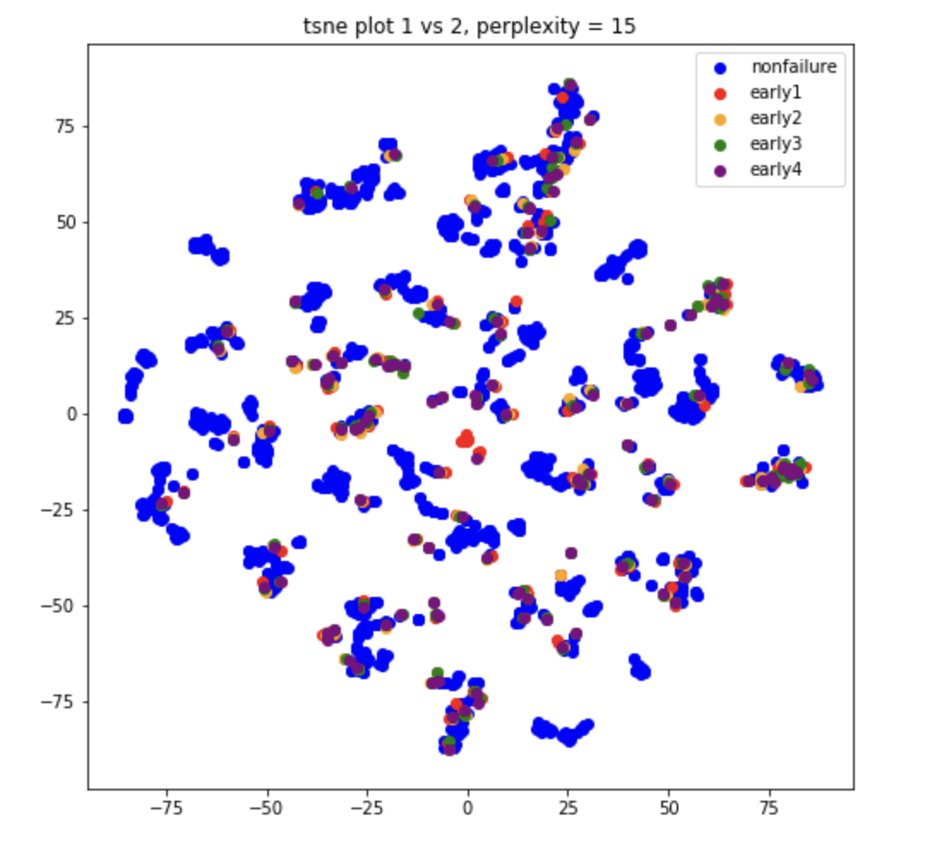
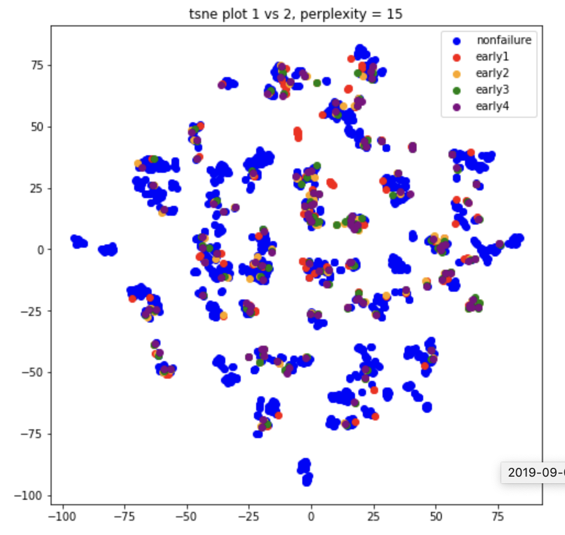
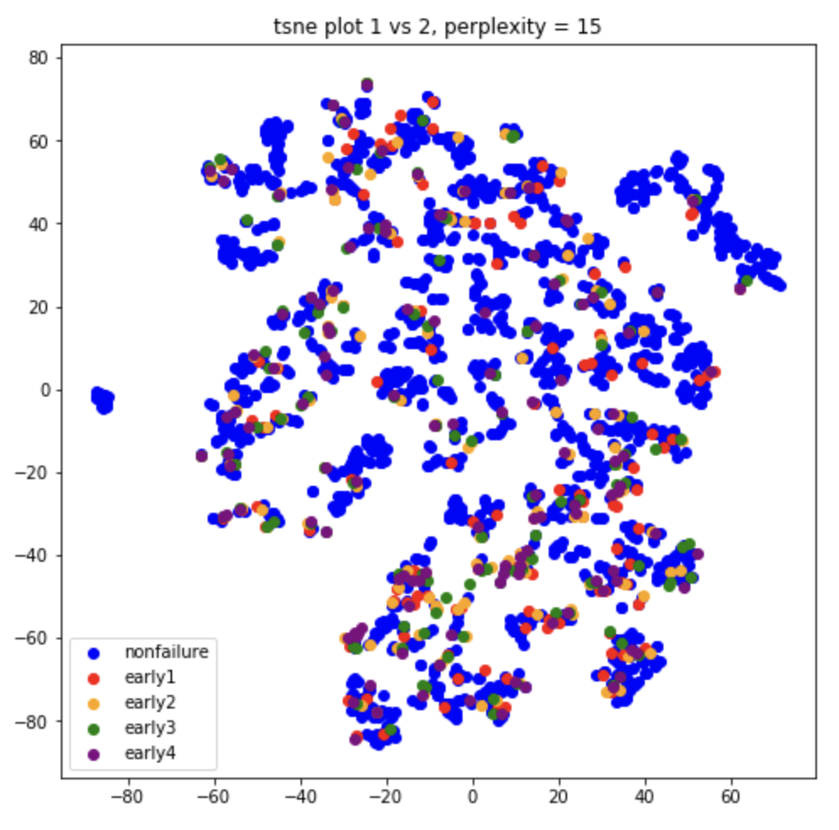
Visualization of encoded representation with t-sne
Sensor inputs
Encoded Data
Encoded Data – xgb selected features (top 15)
T-sne is not able to separate failures from non-failures

Slide 14
Next Steps
Benchmark against other datasets
Develop code base for reuse
Assess time series autoencoders and variational autoencoders
Find other ways to assess reconstruction errors
Apply to UTC use case

